Slide 1






Foundations of
Quantum Information Science (QIS 102)
Dave Biersach
Brookhaven National Laboratory
dbiersach@bnl.gov
Session 16
Simulation and Modeling

Slide 2
Session 16 – Goals
Learn about Python's dictionary data structure and how to read data files in CSV and JSON formats
Analyze chemical trends and anomalies across the Periodic Table of Elements
Implement the linear regression formulas to find the line of best fit using the method of least squares created by Gauss
Identify an unknown element using the Ideal gas law
Derive the least squares equations using partial derivatives to calculate the coefficients of a quadratic model
Use scikit-learn to perform linear regression

Slide 3
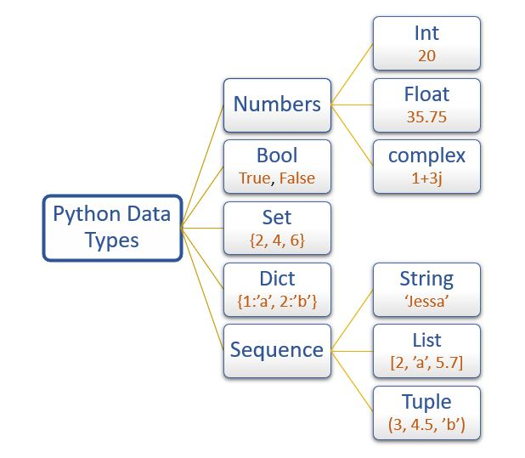
Python Built-In Data Types
Only
sequence types support indexed [] access
But you can use enumerate() with all of these data types

Slide 4
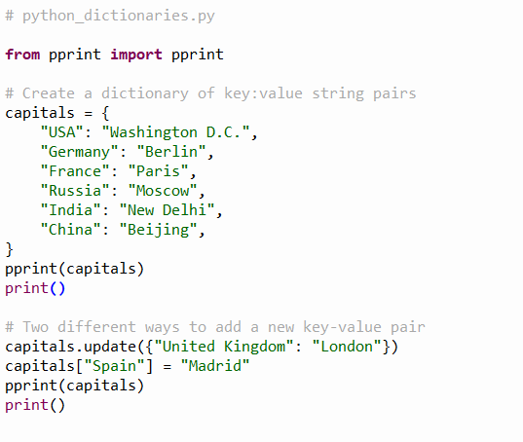
Open python_dictionaries.py
①
“Pretty Printer"
②
"Key-Value Pairs"
Keys
Values
②
③
④
⑤
⑥

Slide 5
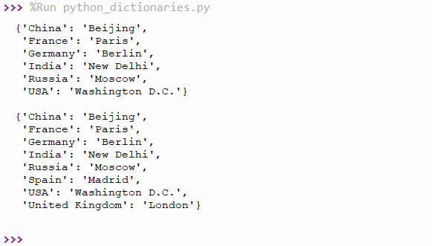
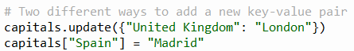
Run python_dictionaries.py
Scroll to the top of your VS Code “Terminal” window to see the following output of the first two calls to pprint()
The original dictionary

Slide 6
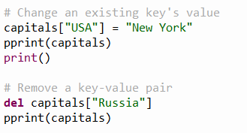
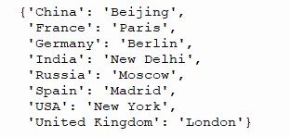
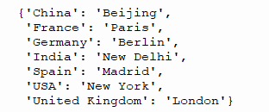
Check python_dictionaries.py
Scroll down to the bottom of your “Terminal" window to see the above output

Slide 7
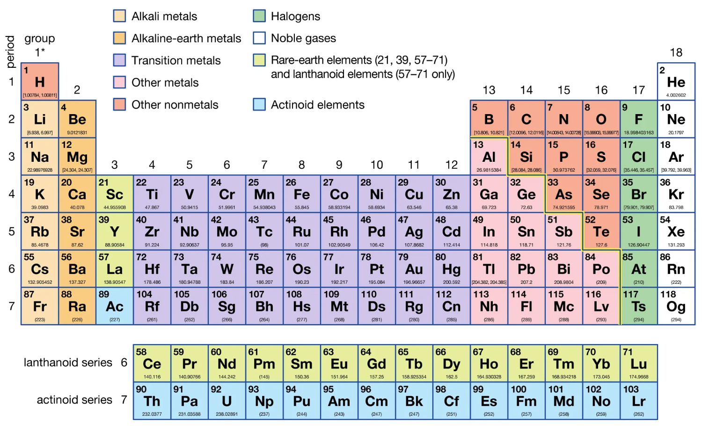
The Periodic Table (circa 2021)

Slide 8
The Periodic Table (circa 2021)
All elements in a group have the same number of valence electrons. As a result, elements in the same group often display similar properties and reactivity.
All elements in a period have the same number of electron shells. Each next element in a period has one more proton and is less metallic than its predecessor.

Slide 9
The Periodic Table (circa 2021)
U-238
# of Protons = 92
# of Neutrons = 146

Slide 10
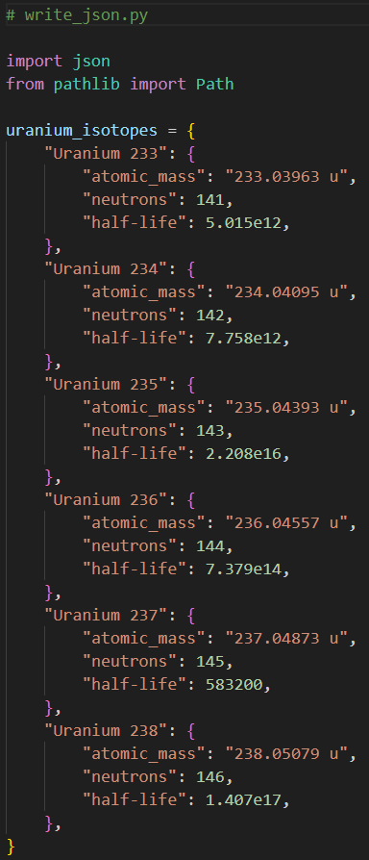
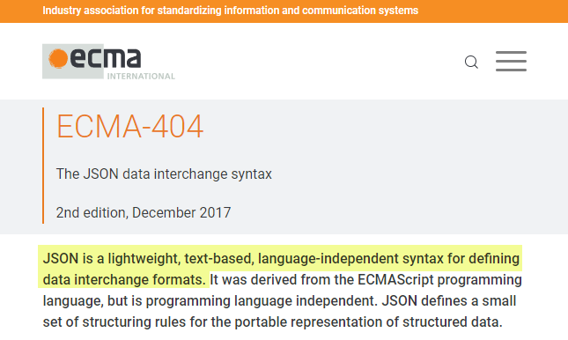
Open write_json.py
①
②
③
④
JavaScript Object Notation (JSON)
⑤
https://www.json.org
"Key-Value Pairs"
⑥
⑦

Slide 11
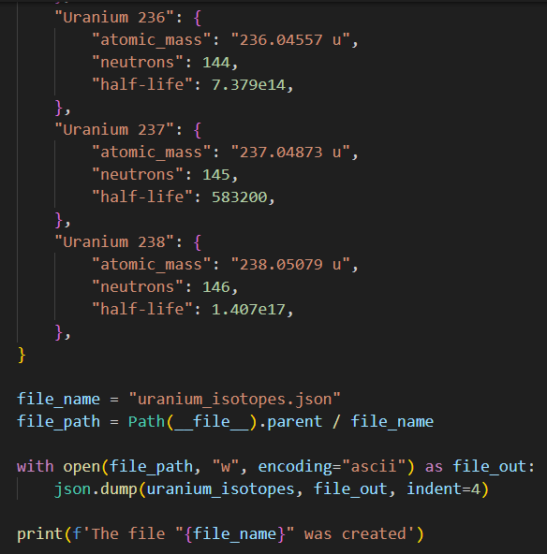
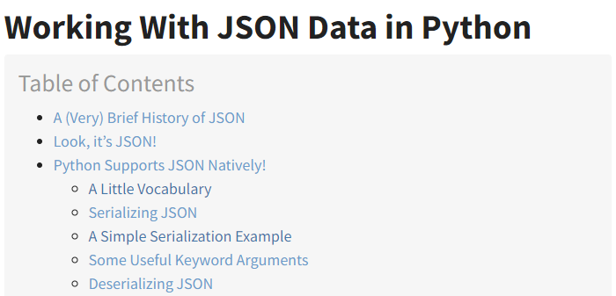
View write_json.py
https://realpython.com/python-json
①
②
③
④

Slide 12
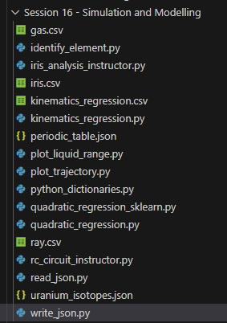
Run uranium_isotopes.json

Slide 13
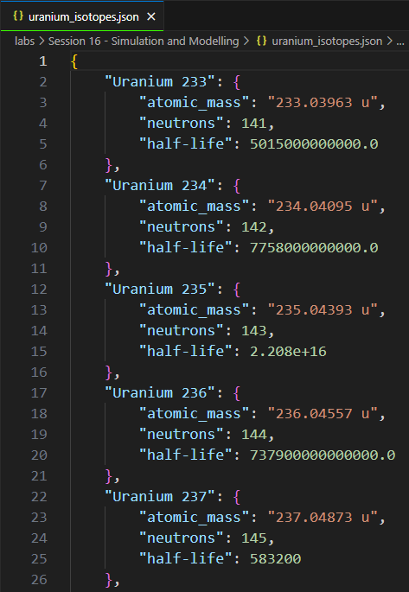
Open uranium_isotopes.json

Slide 14
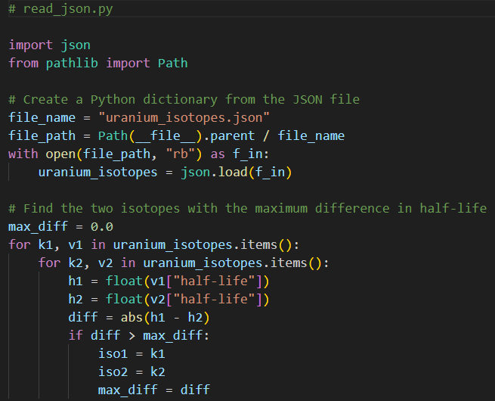
Open read_json.py
Which two isotopes of Uranium differ the most in half-life?
①
②
③
④
Key-Value Pairs
⑤
⑥
k# = key
v# = value
h# = half-life
iso# = isotope
⑦
⑧
⑨
⑩

Slide 15
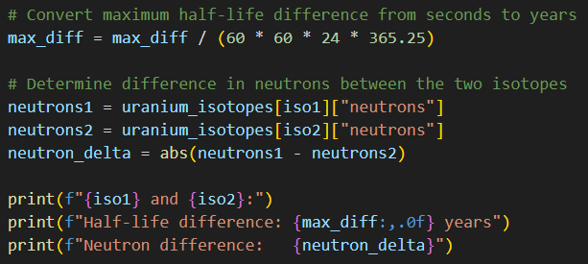
View read_json.py
Which two isotopes of Uranium differ the most in half-life?
①
②
③
④
⑤
⑥

Slide 16
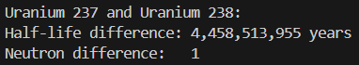
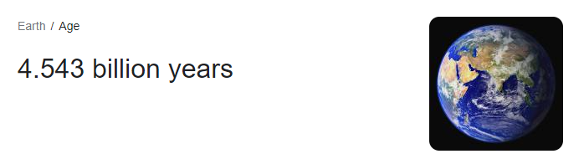
Run read_json.py
Which two isotopes of Uranium differ the most in half-life?
①
②
③
One tiny neutron can make a world of difference

Slide 17
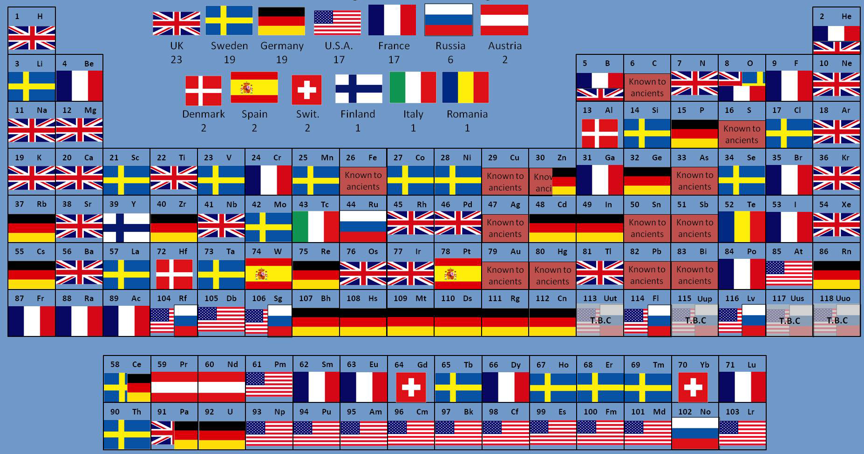
Elements By Country of Discovery

Slide 18
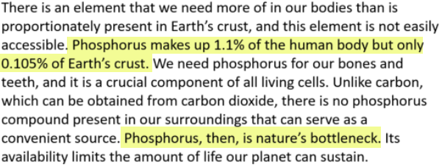
One Element
https://wou.edu/chemistry/courses/online-chemistry-textbooks

Slide 19
"It's not what you look at that matters, it's what you see." Henry David Thoreau (1846)
Scientists have measured the various electrical impulses traveling up the major nerves stemming from our eyes, ears, nose, tongue, and skin that ultimately signal our brain
We have determined that more than 80% of our total sensory input comes from our eyes – we are an incredibly visual species
Humans do poorly at spotting trends in tabular data, whereas graphical charts enable us to sense trends and quickly spot anomalies
The boring old periodic chart is full of surprising art if we can find ways to better visualize the data

Slide 20
Highs & Lows and Unexpected Jumps
Your scientist has asked you to plot the melting and boiling point of each element across the periodic chart
She is interested in visualizing any trends and discontinuities in elements having the same valence shell structure
Therefore, she wants you to plot the elements first by group, then by period, then by atomic number order
She has asked you to include elements from both the Lanthanoid and Actinoid series
Is there a readily available JSON data set on the web that encodes the periodic chart?

Slide 21
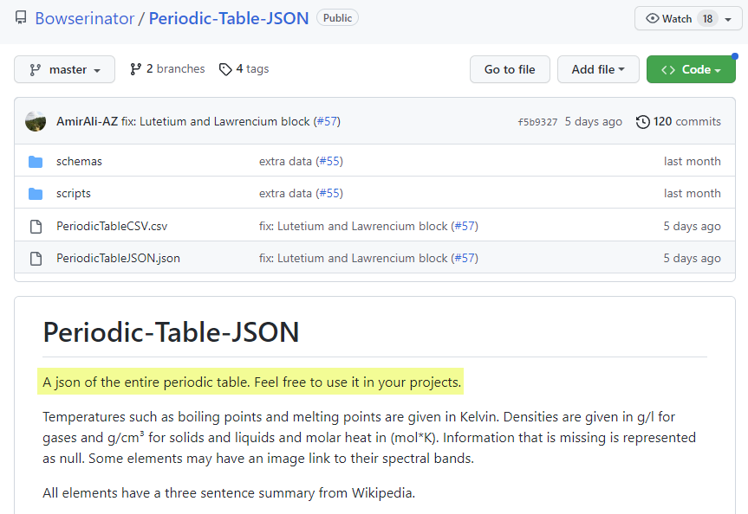
The Periodic Table as JSON
https://github.com/Bowserinator/Periodic-Table-JSON

Slide 22
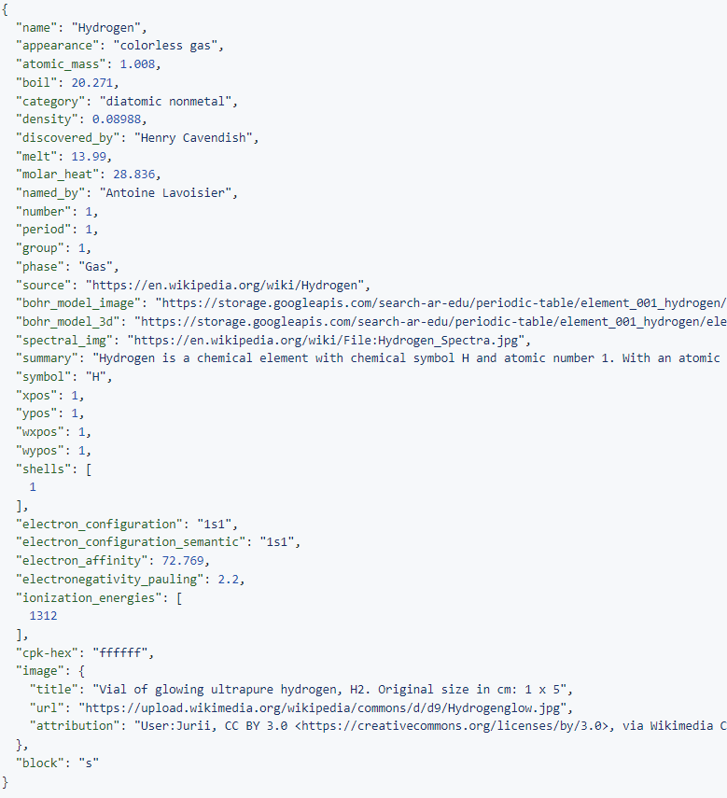
⑥
periodic_table.json
⑤
JSON is like a
Python dictionary with keys and values
②
④
③
①
A value can itself be a "nested" dictionary

Slide 23
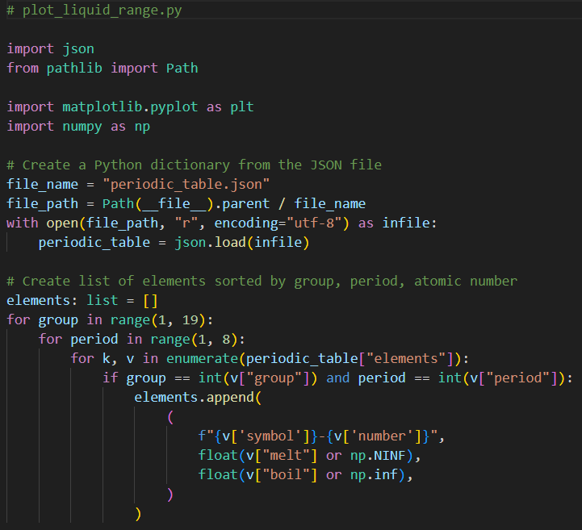
Open plot_liquid_range.py
①
②
③
④
⑤
⑥
⑦
⑧
elements becomes a list of tuples of three items each
⑨
⑩

Slide 24
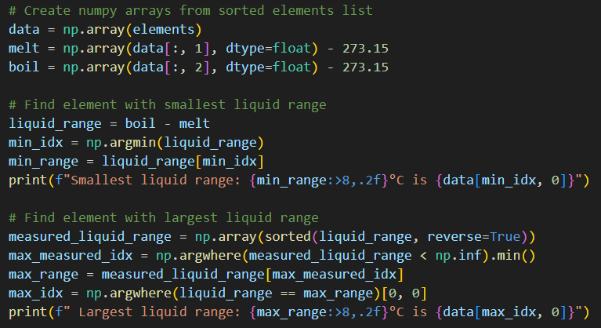
View plot_liquid_range.py
①
Convert Kelvin to Celsius
②
③
⑤
④
⑥
⑦
⑧
⑨
https://numpy.org/doc/stable/reference/generated/numpy.argwhere.html
⑩
$$A\left[\left[34\right]\right]→A.shape=(1,1)→A\left[0\right]=\left[34\right]→A\left[0\right]\left[0\right]=34$$

Slide 25
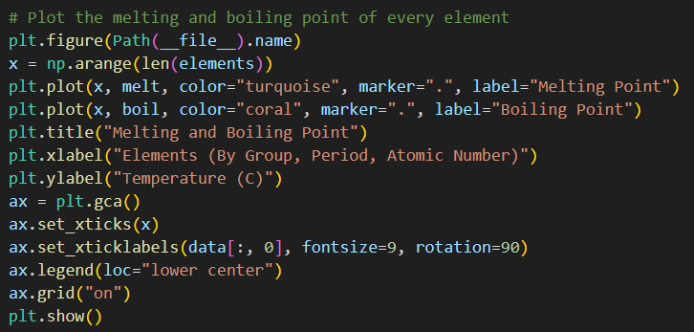
View plot_liquid_range.py
①
②
③
④
⑤
⑥
⑦

Slide 26
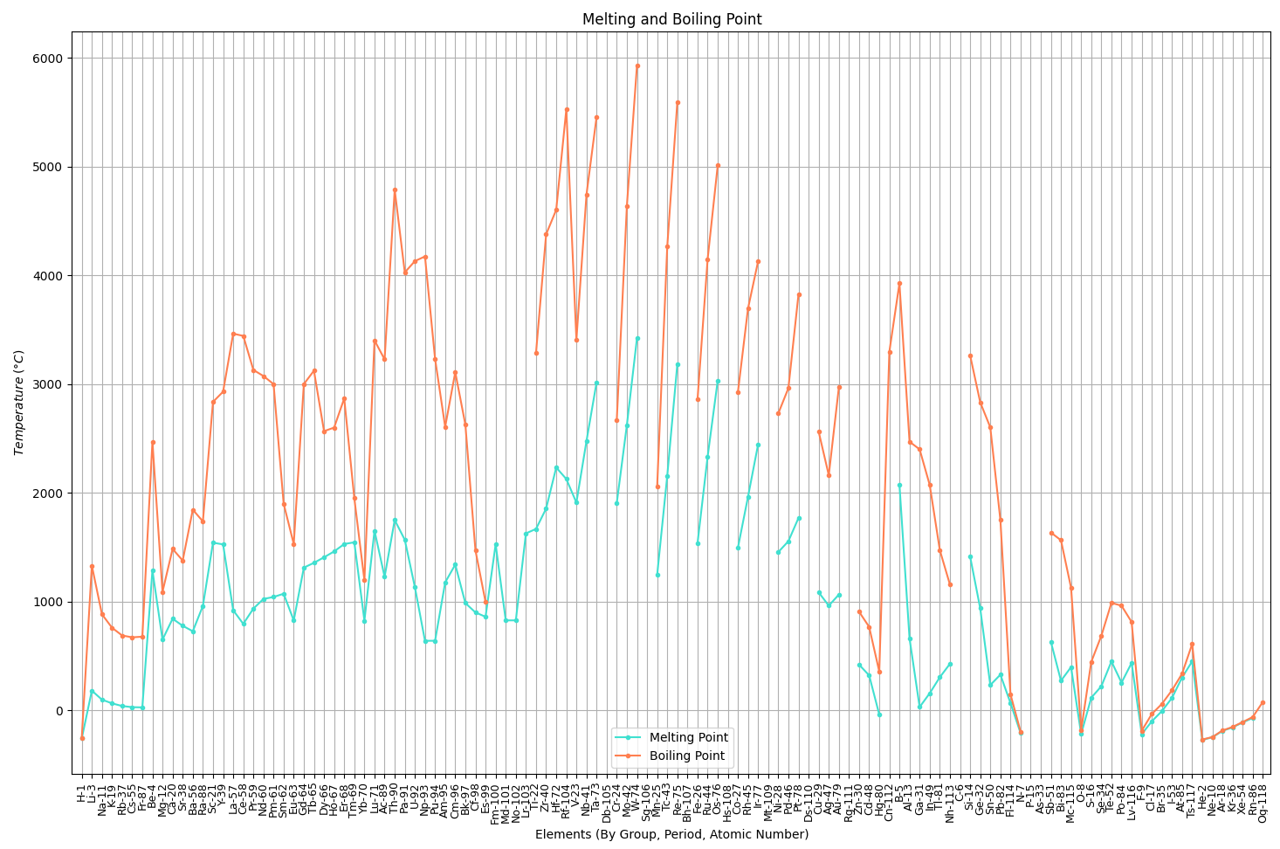
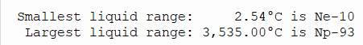
Run plot_liquid_range.py
Neptunium has the largest liquid range of any element
Neon has the smallest liquid range of any element

Slide 27
Carbon doesn't have a melting point – it sublimes
Its boiling point is estimated to be 8,700°F!
Hassium-108 is currently the heaviest element for which we can measure some chemistry

Slide 28
Rutherfordium has a half-life of 48 minutes
Tungsten is too brittle for airplane wings
Tantalum is a
conflict resource
Rhenium is very rare
Osmium is ultra rare
Zirconium reacts with water at high temperatures At Mach 3 airplane skin
temperatures reach 900 °C
Hafnium spontaneously combusts when exposed to air
Titanium has excellent
ductility and strength!
What material should we use to build a
supersonic airplane?

Slide 29
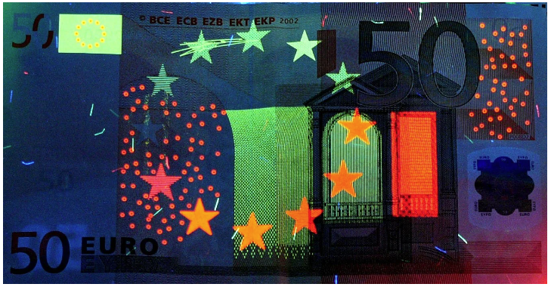
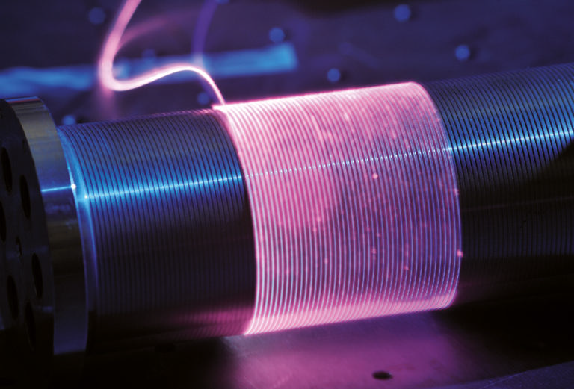
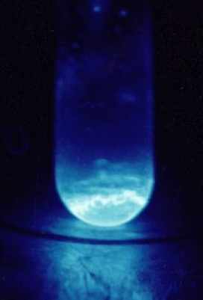
Beryllium is 50% stronger than steel
Liquid-fuel rockets use nozzles of pure beryllium
Europium is used to identify counterfeit Euros
Ytterbium is used to make flexible (fiber) lasers
Einsteinium produces 1000W of heat per gram

Slide 30
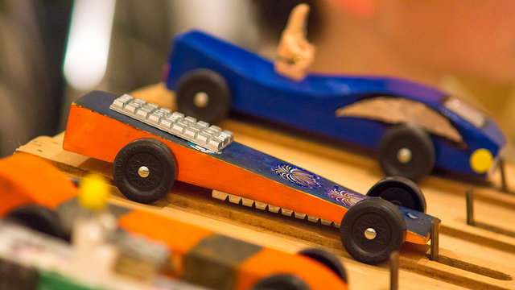
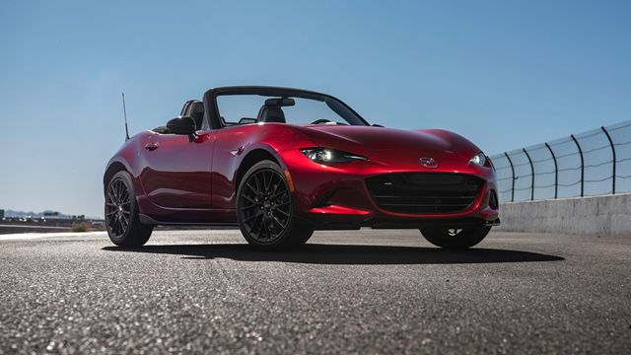
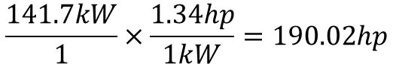
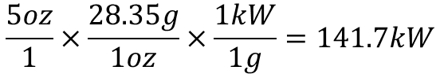
How Energetic is Einsteinium?
5 oz
190 hp
2019 Mazda Miata
$$\frac{5oz}{1}×\frac{28.35g}{1oz}×\frac{1kW}{1g}=141.7kW$$
Einsteinium produces 1000W of heat per gram
$$\frac{141.7kW}{1}×\frac{1.34hp}{1kW}=190.02hp$$

Slide 31
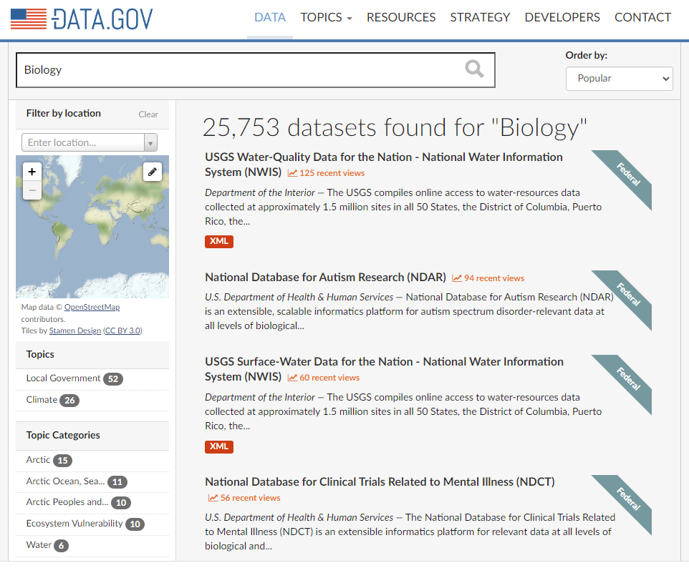
DATA.GOV
https://catalog.data.gov

Slide 32
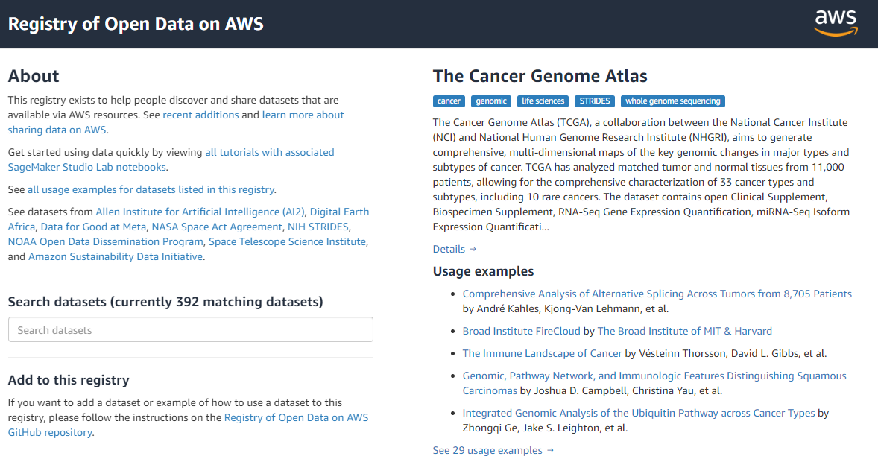
Amazon Open Data Sets
https://registry.opendata.aws

Slide 33
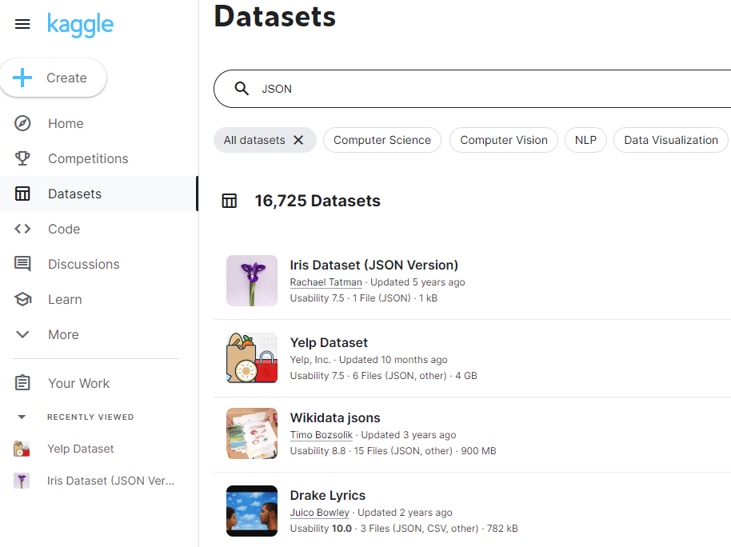
Kaggle
https://www.kaggle.com/datasets

Slide 34
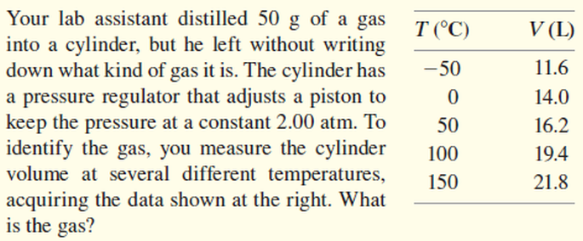
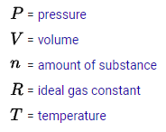
Identify an Unknown Element
$$PV=nRT$$
SI Units
$$V=\left(\frac{nR}{P}\right)T$$
constant
pascals (Pa)
meters³
$$y=mx$$
constant
constant
$$V=\left(m\right)T$$
kelvin (K)
constant

Slide 35
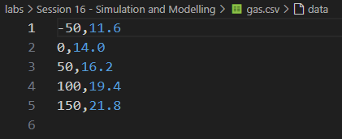
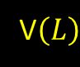

Open gas.csv
CSV = Comma Separated Value (a "text" file)
$$T\left(°C\right)$$
V$\left(L\right)$

Slide 36
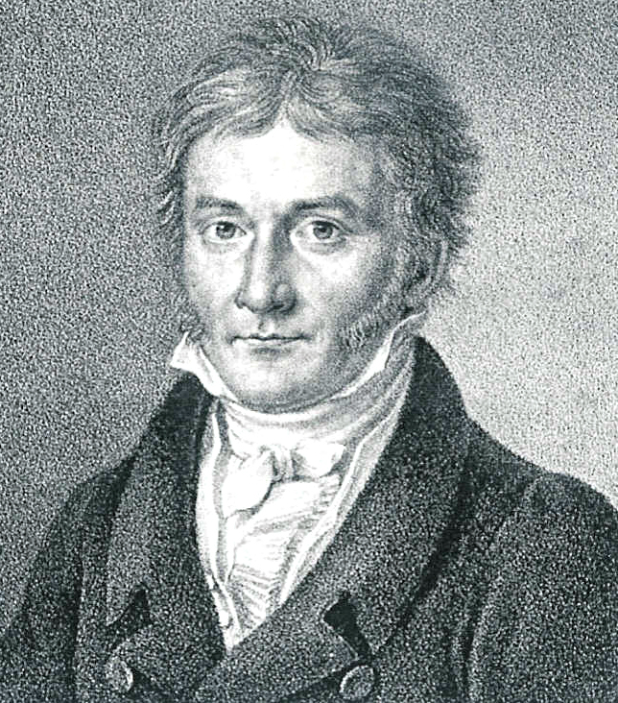
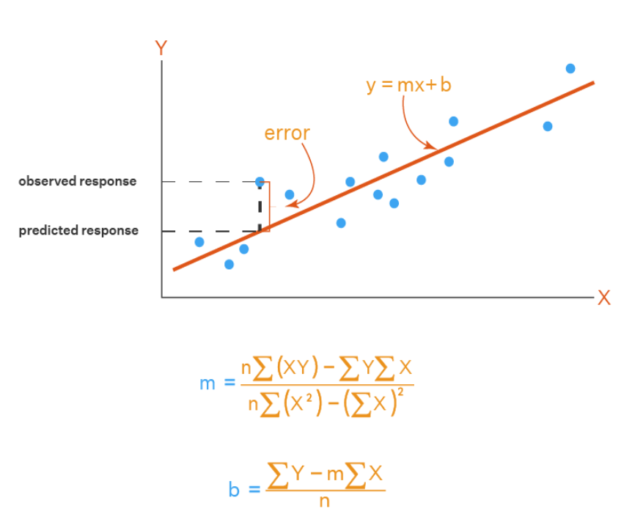
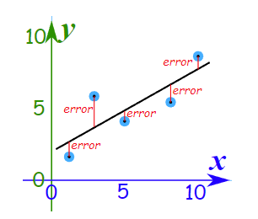
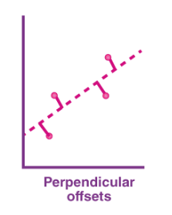
Method of Least Squares
Carl Friedrich Gauss
(1777-1855)

Slide 37
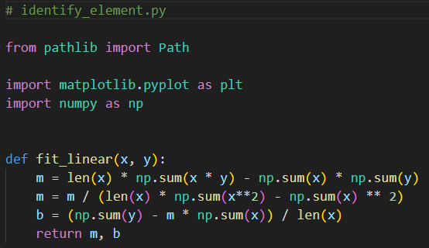
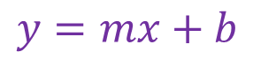
Open identify_element.py
$$y=mx+b$$

Slide 38
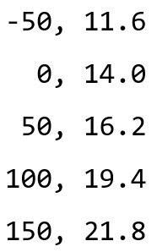
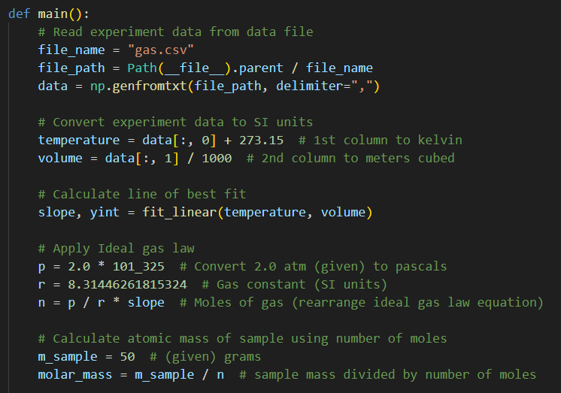
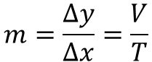


View identify_element.py
①
Slope of line of best fit
$$m=\frac{Δy}{Δx}=\frac{V}{T}$$
②
$$PV=nRT$$
③
$$n=\left(\frac{P}{R}\right)\left(\frac{V}{T}\right)=\frac{P}{R}\left(m\right)$$
④
⑤
Molar Mass $=$ Atomic Mass (specific isotope) $≈$ Atomic Weight (avg)

Slide 39

View identify_element.py
①
②
③
④

Slide 40

Run identify_element.py

Slide 41




Slide 42


Check identify_element.py
Argon is the third-most abundant gas in Earth's atmosphere
It is 2x more abundant than water vapor
It is 23x more abundant than carbon dioxide

Slide 43
Cosmic Rays
Cosmic rays entering the Earth's atmosphere collide with gas molecules, creating secondary particles
Your scientist has developed an instrument to capture the trajectory of these secondary particles as they rain down

Slide 44


Cosmic Rays

Slide 45
Cosmic Rays
Cosmic rays entering the Earth's atmosphere collide with gas molecules, creating secondary particles
Your scientist has developed an instrument to capture the trajectory of these secondary particles as they rain down
He has given you a data file (ray.csv) of a particle's height (in centimeters) over the final nanoseconds before its impact

Slide 46

Cosmic Rays
ray.csv

Slide 47

Cosmic Rays
Cosmic rays entering the Earth's atmosphere collide with gas molecules, creating secondary particles
Your scientist has developed an instrument to capture the trajectory of these secondary particles as they rain down
He has given you a data file (ray.csv) of a particle's height (in centimeters) over the final nanoseconds before its impact
The scientist knows the secondary particle was not accelerating and lived for only 0.1743 milliseconds
He wants you to determine its velocity (relative to $c$) and the height (in km) in the stratosphere at which it was originally emitted

Slide 48


Slide 49

Cosmic Rays
Cosmic rays entering the Earth's atmosphere collide with gas molecules, creating secondary particles
Your scientist has developed an instrument to capture the trajectory of these secondary particles as they rain down
He has given you a data file (ray.csv) of a particle's height (in centimeters) over the final nanoseconds before its impact
The scientist knows the secondary particle was not accelerating and lived for only 0.1743 milliseconds
He wants you to determine its velocity (relative to $c$) and the height (in km) in the stratosphere at which it was originally emitted
How would you display the particle's path and use the line of best fit to determine those two unknowns?

Slide 50

Open plot_trajectory.py
①
②

Slide 51

View plot_trajectory.py
①
②
③
④
⑤
⑥
⑦

Slide 52

View plot_trajectory.py
①
②
③
④
⑤
⑥

Slide 53



Run plot_trajectory.py
Detector Top
2.37m
$$h=vt→v=\frac{h}{t}$$
$$v=\left(\frac{Δh}{Δt}\right)$$
Detector Bottom

Slide 54



Check plot_trajectory.py
$$h=vt→v=\frac{h}{t}$$
$$v=\frac{23.8082 cm}{ns}×\frac{{10}^{9} ns}{1 s}×\frac{1 m}{100 cm}×\frac{1 s}{299,709, 000 m}=0.79 c$$
Given the lifetime of the particle
$$t=\frac{0.1743 ms}{1}×\frac{1 s}{1000 ms}=0.0001743 s$$
$$h=\left(238,082,000\right)\frac{m}{s}×\left(0.0001743\right)\frac{s}{1}×\frac{1 km}{1000 m}=41.50 km$$

Slide 55


Slide 56

Quadratic Regression
Find an equation to model the tape counter as a function of playing time
X is the number of 10-minute blocks the tape has been playing from the beginning (1…8)
Y is the counter on the tape player (linear feet)
With a precise model, we can answer this question:
Where should we stop the tape to be exactly 45 minutes into the recording?

Slide 57

Quadratic Regression
$$Assume$$
$$y=ax^{2}+bx+c$$

Slide 58
Quadratic Regression
$$Minimize S= \sum_{i=1}^{n}{{\left[y_{i}−\left(ax_{i}^{2}+bx_{i}+c\right)\right]}^{2}}$$
$$\left(y−{ax}^{2}−bx−c\right)\left(y−{ax}^{2}−bx−c\right)$$
$$y^{2}−ax^{2}y−bxy−cy$$
$$−ax^{2}y +a^{2}x^{4}+abx^{3}+acx^{2}$$
$$−bxy +abx^{3} +b^{2}x^{2}+bcx$$
$$−cy +acx^{2} +bcx+c^{2}$$
$$S=y^{2}−2ax^{2}y−2bxy−2cy+a^{2}x^{4}+2abx^{3}+2acx^{2}+b^{2}x^{2}+2bcx+c^{2}$$
Note: we will set aside the summation operator for now…

Slide 59
Quadratic Regression
$$Minimize S= \sum_{i=1}^{n}{{\left[y_{i}−\left(ax_{i}^{2}+bx_{i}+c\right)\right]}^{2}}$$
$$S=y^{2}−2ax^{2}y−2bxy−2cy+a^{2}x^{4}+2abx^{3}+2acx^{2}+b^{2}x^{2}+2bcx+c^{2}$$
For S to have a minimum, these partial derivatives must exist:
$$\frac{∂S}{∂a}=0,\frac{∂S}{∂b}=0,\frac{∂S}{∂c}=0$$
$$\frac{∂S}{∂a}=−2x^{2}y+2ax^{4}+2bx^{3}+2cx^{2}=0$$
$$\frac{∂S}{∂b}=−2xy+2ax^{3}+2bx^{2}+2cx=0$$
$$\frac{∂S}{∂c}=−2y+2ax^{2}+2bx+2c=0$$

Slide 60
Quadratic Regression
$$Minimize S= \sum_{i=1}^{n}{{\left[y_{i}−\left(ax_{i}^{2}+bx_{i}+c\right)\right]}^{2}}$$
$$\frac{∂S}{∂a}=−2x^{2}y+2ax^{4}+2bx^{3}+2cx^{2}=0$$
Divide through by the GCD of all terms
Move all terms not containing a, b, or c
to the RHS
$$\left(x^{4}\right)a+\left(x^{3}\right)b+\left(x^{2}\right)c=x^{2}y$$
$$\frac{∂S}{∂b}=−2xy+2ax^{3}+2bx^{2}+2cx=0$$
$$\left(x^{3}\right)a+\left(x^{2}\right)b+\left(x\right)c=xy$$
$$\frac{∂S}{∂c}=−2y+2ax^{2}+2bx+2c=0$$
$$\left(x^{2}\right)a+\left(x\right)b+c=y$$

Slide 61


Quadratic Regression
$$Minimize S= \sum_{i=1}^{n}{{\left[y_{i}−\left(ax_{i}^{2}+bx_{i}+c\right)\right]}^{2}}$$
$$\sum_{i=1}^{n}{\left(1\right)c=\left(n\right)c}$$
Reintroduce the operators
But all values are sums of known (observed) values!
$$\left(\sum{x_{i}^{4}}\right)a+\left(\sum{x_{i}^{3}}\right)b+\left(\sum{x_{i}^{2}}\right)c = \left(\sum{x_{i}^{2}y_{i}}\right)$$
$$\left(\sum{x_{i}^{3}}\right)a+\left(\sum{x_{i}^{2}}\right)b+\left(\sum{x_{i}}\right)c = \left(\sum{x_{i}y_{i}}\right)$$
$$\left(\sum{x_{i}^{2}}\right)a+\left(\sum{x_{i}}\right)b+ \left(n\right)c = \left(\sum{y_{i}}\right)$$
Pretend all the values were just some numbers….

Slide 62
Quadratic Regression
$$Minimize S= \sum_{i=1}^{n}{{\left[y_{i}−\left(ax_{i}^{2}+bx_{i}+c\right)\right]}^{2}}$$
This is just a system of 3 linear equations and 3 unknowns!
$$\left(4\right)a+ \left(5\right)b+\left(−2\right)c=\left(−14\right)$$
$$\left(7\right)a+\left(−1\right)b+ \left(2\right)c= \left(42\right)$$
$$\left(3\right)a+ \left(1\right)b+ \left(4\right)c= \left(28\right)$$

Slide 63
Quadratic Regression
$$Minimize S= \sum_{i=1}^{n}{{\left[y_{i}−\left(ax_{i}^{2}+bx_{i}+c\right)\right]}^{2}}$$
This is just a system of 3 linear equations and 3 unknowns!
$$\left(\sum{x_{i}^{4}}\right)a+\left(\sum{x_{i}^{3}}\right)b+\left(\sum{x_{i}^{2}}\right)c = \left(\sum{x_{i}^{2}y_{i}}\right)$$
$$\left(\sum{x_{i}^{3}}\right)a+\left(\sum{x_{i}^{2}}\right)b+\left(\sum{x_{i}}\right)c = \left(\sum{x_{i}y_{i}}\right)$$
$$\left(\sum{x_{i}^{2}}\right)a+\left(\sum{x_{i}}\right)b+ \left(n\right)c = \left(\sum{y_{i}}\right)$$
Coefficient Matrix
Value Vector

Slide 64

Open quadratic_regression.py
$$Minimize S= \sum_{i=1}^{n}{{\left[y_{i}−\left(ax_{i}^{2}+bx_{i}+c\right)\right]}^{2}}$$
$$\left(\sum{x_{i}^{4}}\right)a+\left(\sum{x_{i}^{3}}\right)b+\left(\sum{x_{i}^{2}}\right)c = \left(\sum{x_{i}^{2}y_{i}}\right)$$
$$\left(\sum{x_{i}^{3}}\right)a+\left(\sum{x_{i}^{2}}\right)b+\left(\sum{x_{i}}\right)c = \left(\sum{x_{i}y_{i}}\right)$$
$$\left(\sum{x_{i}^{2}}\right)a+\left(\sum{x_{i}}\right)b+ \left(n\right)c = \left(\sum{y_{i}}\right)$$

Slide 65

View quadratic_regression.py
①
②
Overlay the value vector onto the coefficients matrix
③
④
⑤
⑥
We will use Cramer's Rule to solve this 3x3 system of equations!

Slide 66

View quadratic_regression.py
①
②
③
④
⑤
⑥
⑦
⑧
⑨
⑩
Gabriel Cramer’s Rule (1750) – Gauss Least Squares (1795)

Slide 67

Run quadratic_regression.py

Slide 68

Machine Learning in Python
https://scikit-learn.org

Slide 69

Linear Regression in Python
https://realpython.com/linear-regression-in-python

Slide 70


Open quadratic_regression_sklearn.py
①
Boost shape [8,] to become [8,1]
②
③
④
⑤
⑥

Slide 71

View quadratic_regression_sklearn.py
①
②
③
④
⑤
⑥
⑦
⑧
By using PolynomialFeatures(degree=…) you can easily fit higher-order polynomials to your data, including cubic, quartic, quintic, etc. curves

Slide 72
Run quadratic_regression_sklearn.py

Slide 73
Session 16 – Now You Know…
A dictionary in Python stores a series of key-value pairs, with the key and the value separated with a colon
Dictionary keys can be any immutable type (int, float, str, tuples) while values can be any type, including another dictionary
We can insert/delete keys and enumerate all the keys and their associated values but all keys in a dictionary must be unique
The built-in "Pretty Print" (pprint) function will display a dictionary with proper indentation, etc.
A JavaScript Object Notation (JSON) file follows the same syntax as a Python Dictionary
Numpy can easily load, parse, and save comma separated value (CSV) data files and treats them as arrays

Slide 74
Session 16 – Now You Know…
Gauss's Method of Least Squares (Linear Regression) allows us to calculate the slope and intercept of the line of best-fit passing through data we believe obeys a constant of proportionality relationship
Charles's Gas Law applies when we maintain both constant pressure and number of moles – the volume will then rise/fall in constant proportion to the temperature change
Many potential uses for an element depend heavily upon its melting and boiling point – noble gases stay in liquid form over a very small range of extremely low temperatures
The availability of free and comprehensive datasets opens the door for you to do new kinds of graphical analysis

Slide 75
Session 16 – Now You Know…
Model fitting starts by assuming the degree of an appropriate curve that reasonably matches the data
Quadratic Regression refers to shaping an approximating parabolic curve to minimize the total deviations between the observed data and points on that curve
The function to minimize must be expanded, and then partial derivatives must be found for each coefficient of the curve
Matrix algebra (Cramer's Rule) can then solve for the coefficients
The package scikit-learn has a tremendous number of functions to fit equations to data and to use machine learning algorithms to analyze and classify your data

Slide 76

Task 16-01
Create a Python program kinematics_regression.py to calculate and display the constant acceleration $a$ and initial velocity $v_{0}$ for a moving particle
The times (in seconds) and total distances traveled (in meters) by the particle are provided in the data file kinematics_regression.csv
Your program should also plot the values in the data file and then draw an appropriate smooth curve through the values
Upload your solution to your folder in the QIS102 SharePoint site

Slide 77
Task 16-02
Create a Python program called iris_analysis.py that visualizes the plant data in the file iris.csv downloaded from https://archive.ics.uci.edu/dataset/53/iris
Generate a scatter plot of the flower data, where the domain is the petal length (cm) and the range is the petal width (cm)
Use a different color for the plot markers indicating each of the varieties: Setosa, Veriscolor, and Virginica, and display a legend showing the names of those varieties
Do not use any functions or classes from either the pandas or scikit-learn packages
Upload your solution to the QIS102 SharePoint site

